Slide 1
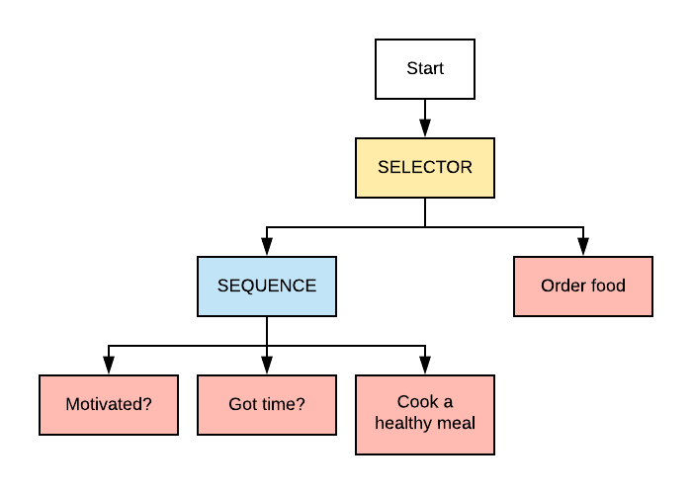
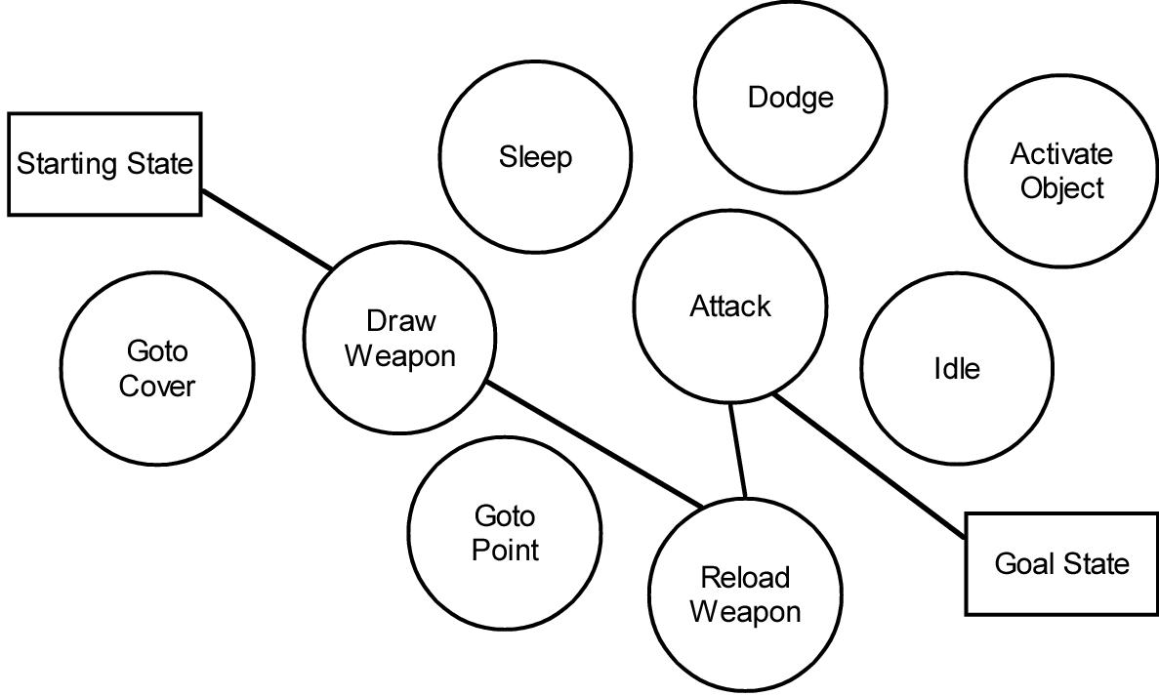
Project 400 Presentation Behaviour Trees VS GOAP
S00189532- Bartlomiej Bialowas

Slide 2
Introduction
This project aims to compare the creation of videogame A.I. (Artificial Intelligence) NPCs(Non-Player Characters) with Behaviour Trees and GOAP(Goal-Oriented Action Planning)
To reach this goal the two identical scenarios will be made for the project with the only difference between them being the creation methods for the NPCs.
The scenarios will consist of three worker NPCs. These NPCs consist of a Miner, Lumberjack and a Blacksmith and their logic will be made with Behaviour Trees for one scenario and GOAP for the other.

Slide 3
Behaviour Trees
A Behaviour Tree is a plan of execution of nodes that contain logic that the NPC making use of the Behaviour Tree will perform.
The are many types of nodes and more being made as Behaviour Trees evolve. The main node types that most Behaviour Trees have are Root, Composite, Action and Decorator nodes.
The Behaviour Tree starts at a root node and more nodes can be connected to it. The nodes get executed from left-to-right and from top-to-bottom

Slide 4
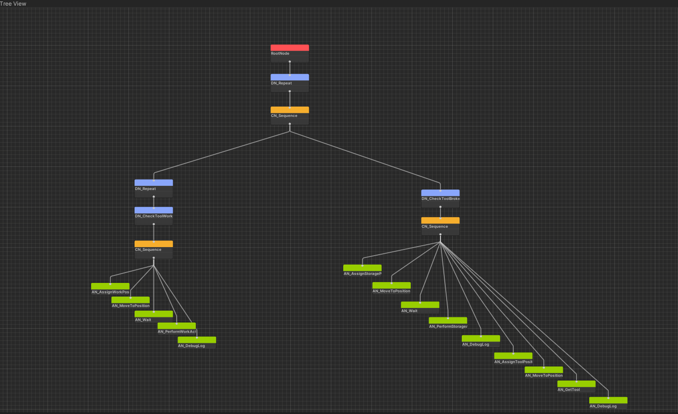
Lumberjack/Miner Behaviour Tree

Slide 5
Goal-Oriented Action Planning
Goal-Oriented Action Planning consists of a planner and a collection of goals and actions with the goals having a priority value and the actions a cost.
There are two main types of GOAP that being microlithic and monolithic. Monolithic GOAP is used for this project because of it scale. This makes it so a goal can be completed by one condensed action instead of multiple smaller ones.
GOAP allows NPCs to make use of a planner to assign themselves a goal and actions they need to complete that goal. The planner assigns goals based on their priority and ability to be completed than using the A* search algorithm assigns a set of actions with the lowest cost to complete the goal.

Slide 6
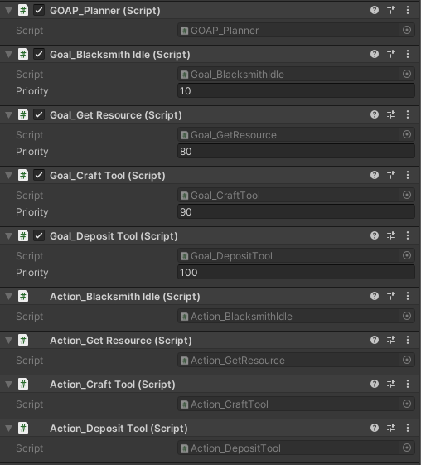
Blacksmith GOAP

Slide 7
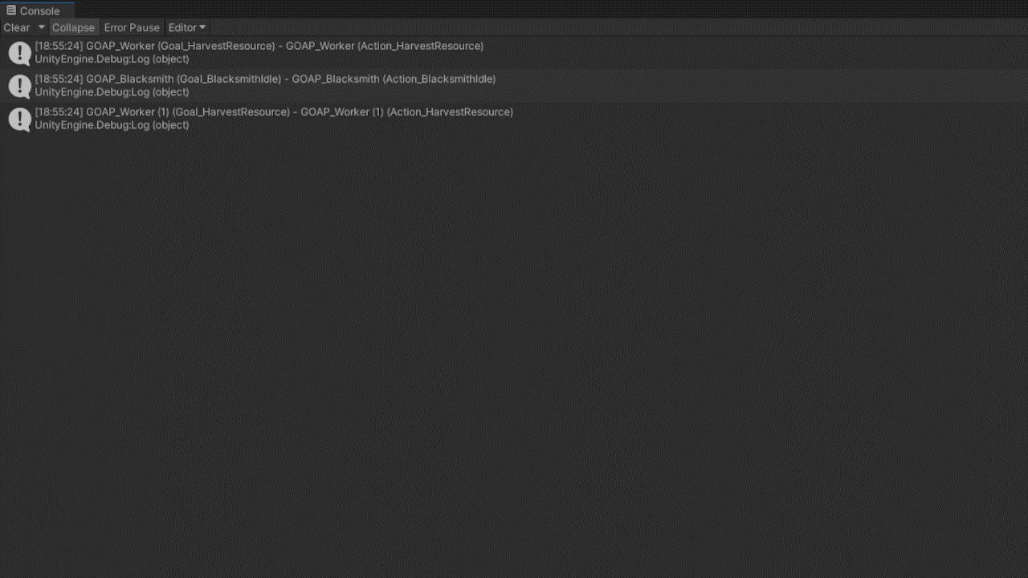
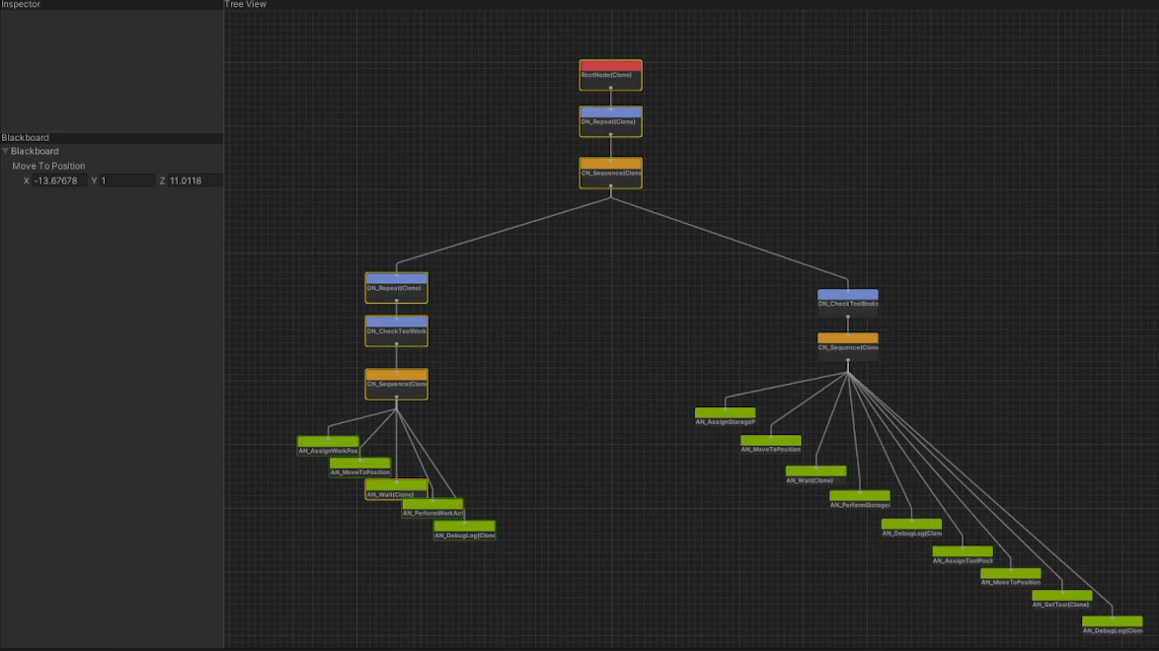
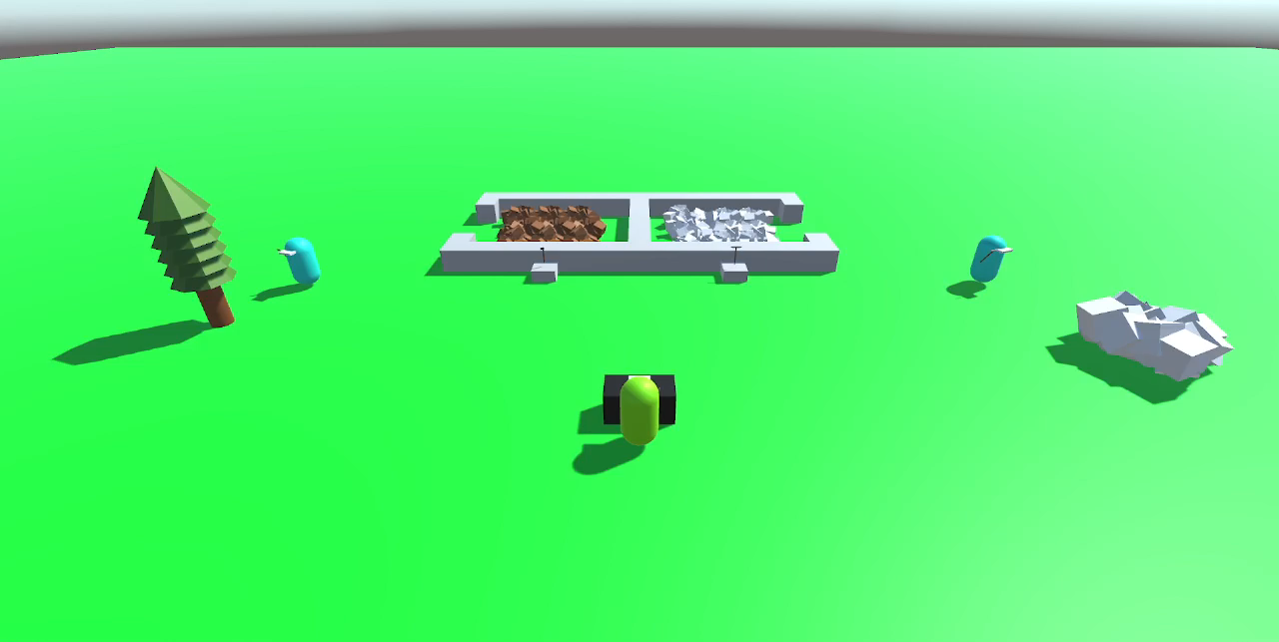

Slide 8
Conclusion
The scale of the project is too small to see any visible differences between the behaviour of the NPCs.
A bigger scale project with constantly changing stimuli that the NPCs have to react to would have shown better results.
More UI in the scene and display of GOAP is needed in the project to make it clearer for the user what is going on.
Animations and better assets would also have been a good addition to properly display what is going on in the scenes.

